Slide 2
Efficient Access to Shared GPU Resources: Mechanisms and Use Cases
Diogo Guerra & Diana Gaponcic, CERN

Slide 3
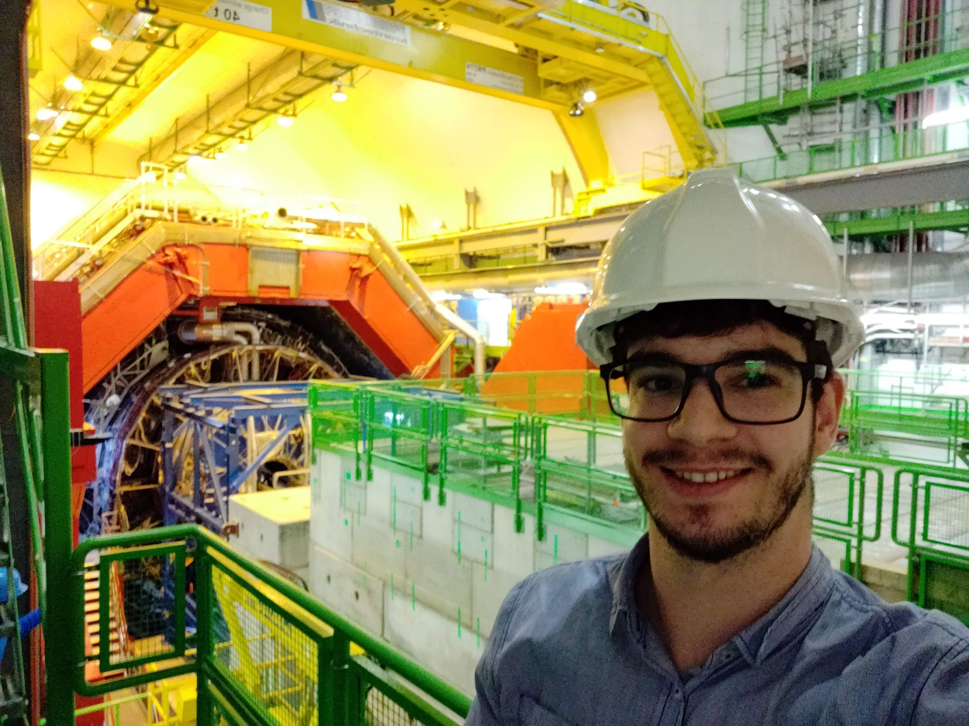
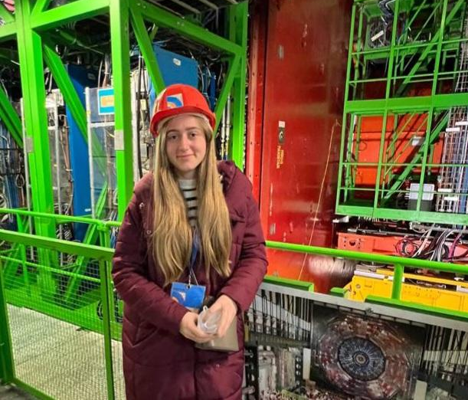
Who
Diogo Guerra - diogo.filipe.tomas.guerra@cern.ch
Computing Engineer with the Kubernetes team @ CERN
Diana Gaponcic - diana.gaponcic@cern.ch
Computing Engineer with the Kubernetes team @ CERN

Slide 4
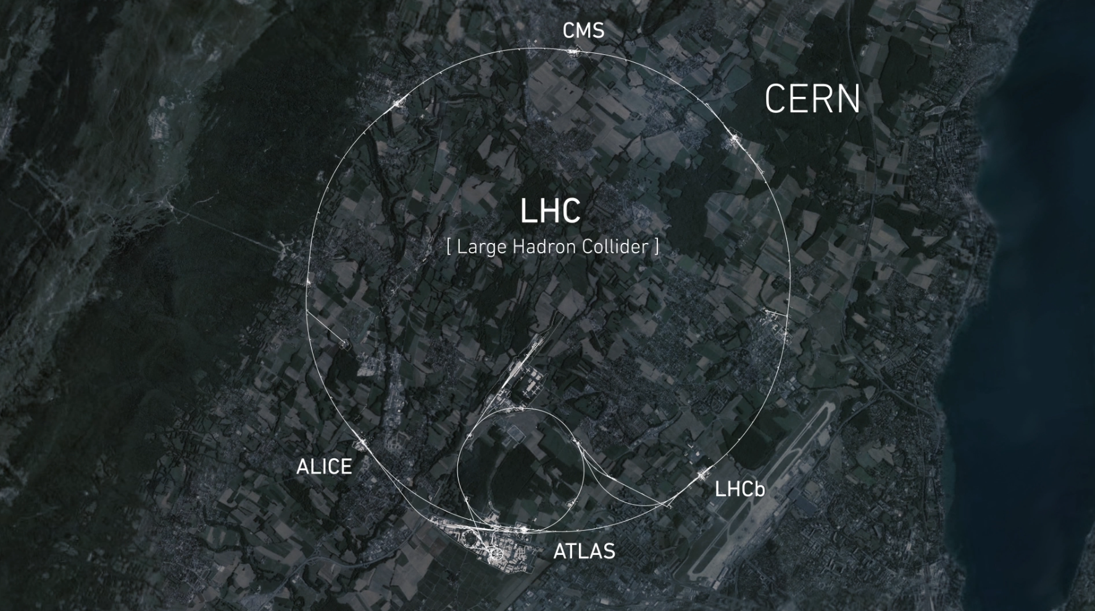
What is CERN

Slide 5
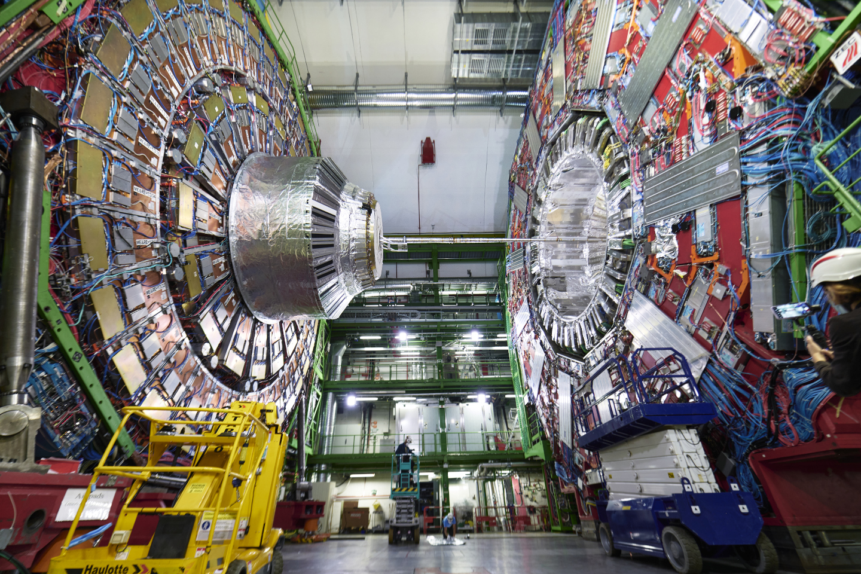
What is CERN

Slide 6
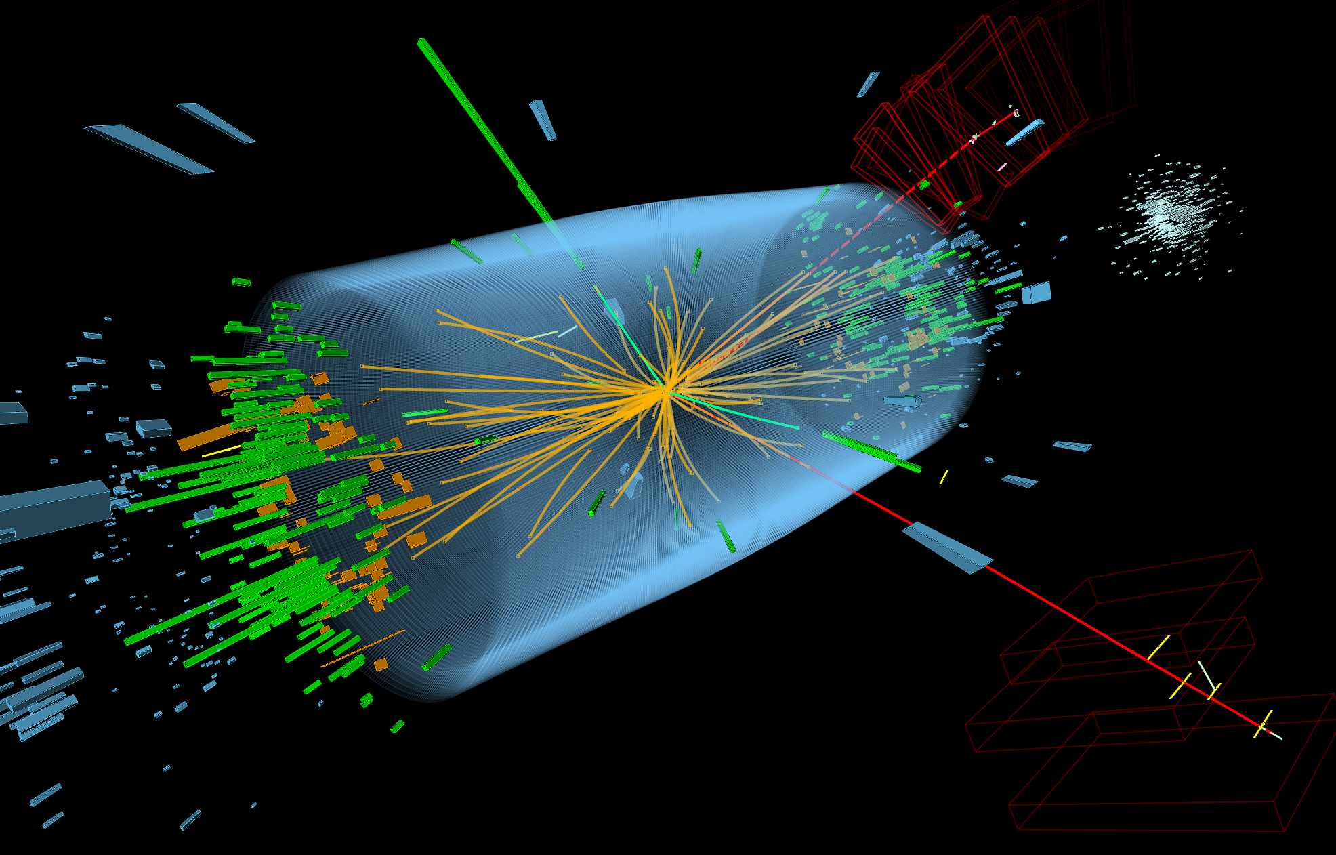
What is CERN
~70 PB/year

Slide 7


Motivation
Some of our use cases for GPUs:
Simulation
Event filtering
Machine Learning:
event reconstruction (GNN)
faster generation of simulation data (3DGAN)
reinforcement learning for beam calibration
CERN Alice GPU Trigger
CERN LHCb High-Level Trigger

Slide 8
Challenges
Efficient GPU usage challenges:
Suboptimal code
Existing workloads’ usage patterns not designed with GPUs in mind
Spiky workloads (ex: Development workflow using interactive tools like Notebooks)
Infrastructure perspective:
GPU power density constraints
Vendor lock-in (ex: cuda, oneapi from Intel, frameworks built on cuda)
Limited resources to meet users’ demand

Slide 9
Story time!
Meet the actors

Slide 10

Meet the actors
Mr Brown
Badly coded simulation job:
Low average GPU usage (CPU dependant workload)
Needs 10 GiB VRAM (8 + 2 dynamic)
Long running process
image source: https://villains.fandom.com/wiki/Mr._Brown

Slide 11

Meet the actors
Mr Pink
An inference service which is occasionally triggered by outside events:
Spiky and unpredictable execution
Mostly sits idle
Saturates the GPU cores
Max 10 GiB VRAM (2 + 8 dynamic)
image source: https://www.unilad.com/featured/reservoir-dogs-is-steve-buscemis-best-movie

Slide 12

Meet the actors
Mr Orange
Never know what to expected from the notebook users:
Potential memory leaks
Poorly considered batch size
GPU memory locked by an idle notebook
image source: https://reservoirdogs.fandom.com/wiki/Mr_Orange

Slide 13
Use Case 1:
User is assigned full GPU card

Slide 14
Let’s onboard Mr Brown

Slide 15
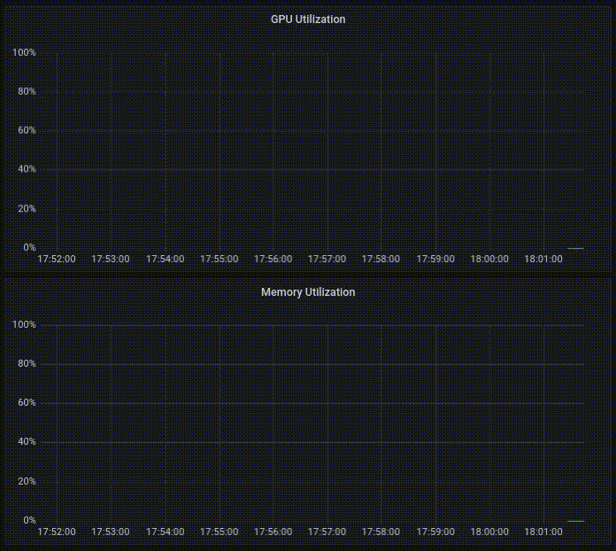
Let’s onboard Mr Brown
GPU underutilized
Steady memory utilization ~ 20%

Slide 16
Use Case 2:
Sharing GPUs with Time Slicing

Slide 17
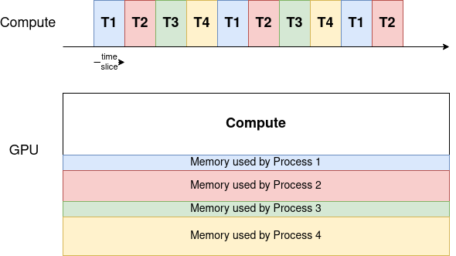
What is Time Slicing
The scheduler gives an equal share of time to all GPU processes and alternates them in a round-robin fashion.
The memory is shared between the processes
The compute resources are assigned to one process at a time

Slide 18
Time Slicing config
# values.yaml in NVIDIA gpu operator Helm chart
...
devicePlugin:
config:
name: nvidia-time-slicing-config
# $ cat nvidia-time-slicing-config.yaml
apiVersion: v1
kind: ConfigMap
metadata:
name: nvidia-time-slicing-config
namespace: kube-system
data:
slice-4: |-
version: v1
sharing:
timeSlicing:
renameByDefault: true
failRequestsGreaterThanOne: true
resources:
- name: nvidia.com/gpu
replicas: 4
When set to true, each resource is advertised under the name <resource-name>.shared instead of <resource-name>.
Allocatable:
…
nvidia.com/gpu: 1
Allocatable:
…
nvidia.com/gpu: 0
nvidia.com/gpu.shared: 4

Slide 19
Now let’s onboard Mr Pink

Slide 20
Let’s onboard Mr Brown and Mr Pink
improved GPU utilization
better memory consumption (~ 50 %)

Slide 21
Let’s risk…
and onboard Mr Orange

Slide 22
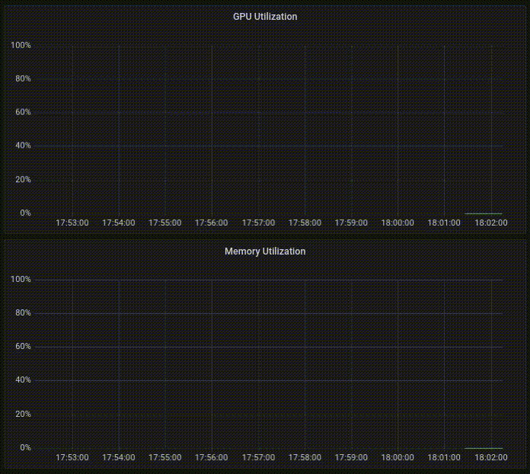
The GPU is fully utilized
GPU utilization 100%
memory consumption increasing

Slide 23

Mr Brown
cause of death: OOM
Mr Pink
cause of death: OOM
water gun credits: https://imgbin.com/png/X1QBfTkA/gun-line-water-gun-png (lieynnhite)

Slide 24
Time Slicing conclusions
Advantages | Disadvantages
Works on a wide range of NVIDIA architectures | No process or memory isolation
An easy way to set up GPU concurrency | No ability to set priorities
An unlimited number of partitions | Inappropriate for latency-sensitive applications (ex: desktop rendering for CAD workloads)

Slide 25
Can we do better?
Yes we can!

Slide 26
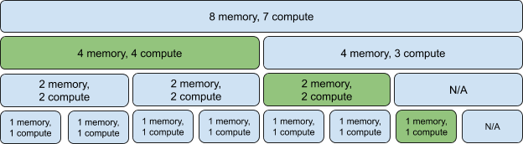
Introducing MIG
Multi Instance GPU (MIG) can partition the GPU into up to seven instances, each fully isolated with its own high-bandwidth memory, cache, and compute cores.
NVIDIA A100 GPU can be partitioned into up to 7 MIG devices
source: http://www.pattersonconsultingtn.com/blog/introduction_to_nvidia_mig.html

Slide 27
MIG config
# values.yaml in NVIDIA gpu operator Helm chart
...
mig:
strategy: mixed
migManager:
config:
name: nvidia-mig-config
apiVersion: v1
kind: ConfigMap
metadata:
name: nvidia-mig-config
data:
config.yaml: |
version: v1
mig-configs:
# A100-40GB
3g.20gb-2x2g.10gb:
- devices: all
mig-enabled: true
mig-devices:
"2g.10gb": 2
"3g.20gb": 1
mixed strategy enumerates resource types for every MIG device available.
Allocatable:
…
nvidia.com/gpu: 1
Allocatable:
…
nvidia.com/gpu: 0
nvidia.com/mig-2g.10gb: 2
nvidia.com/mig-3g.20gb: 1

Slide 28
instance type:
2g.10gb
2/7 Cores
2/8 Memory
instance type: 2g.10gb
2/7 Cores
2/8 Memory
instance type:
3g.20gb
3/7 Cores
4/8 Memory

Slide 29
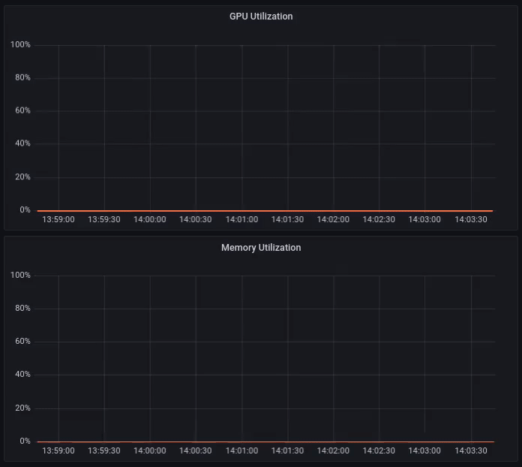
GPU utilization with MIG
Every process:
is isolated
saturates own resources
cannot influence other processes

Slide 30
Now Mr Orange is isolated
It would have been nice to live this long in the movie too!
Alive! Hooray!

Slide 31
MIG Conclusions
Advantages | Disadvantages
Hardware isolation allows processes to run securely in parallel and not influence each other | Only available for Ampere and Hopper architecture (as of mid 2023)
Monitoring and telemetry data available at partition level | Reconfiguring the partition layout requires all running processes to be evicted
Allows partitioning based on use cases, making the solution flexible | Potential loss of available memory depending on chosen profile layout

Slide 32
Performance Tradeoffs?
Let’s benchmark

Slide 33


Benchmarking Setup
Environment:
NVIDIA A100 40GB PCIe GPU
Kubernetes version 1.22
Cuda version utilized: 11.6
Driver Version: 470.129.06
Benchmarked script:
Simulation script that generates collision events
Built with Xsuite (Suite of python packages for multiparticle simulations for particle accelerators)
Very heavy on GPU usage
Low on memory accesses
Low on CPU-GPU communication
Xsuite
Benchmarked Script

Slide 34
Time Slicing performance penalty
Number of particles | Passthrough [seconds] | Shared x1 [seconds] | Loss [%]
10 000 000 | 51.135 | 51.93 | 1.98
15 000 000 | 76.374 | 77.12 | 0.97
20 000 000 | 99.55 | 99.91 | 0.36
30 000 000 | 151.57 | 152.61 | 0.68
Conclusion:
The performance loss when enabling time slicing (shared x1) is negligible.

Slide 35
Time Slicing performance penalty
Number of particles | Shared x1 [seconds] | Expected Shared x2 = Shared x1 * 2 [seconds] | Actual Shared x2 [seconds] | Loss [%]
10 000 000 | 51.93 | 103.86 | 138.76 | 33.6
15 000 000 | 77.12 | 154.24 | 212.71 | 37.90
20 000 000 | 99.91 | 199.82 | 276.23 | 38.23
30 000 000 | 152.61 | 305.22 | 423.08 | 38.61
Conclusion:
If the GPU needs to perform context switching (going from shared x1 to shared x2) it leads to a performance loss of ~38%.

Slide 36
Time Slicing performance penalty
Number of particles | Shared x2 [seconds] | Shared x4 [seconds] | Loss [%]
10 000 000 | 138.76 | 281.98 | 1.6
15 000 000 | 212.71 | 421.55 | 0
20 000 000 | 276.23 | 546.19 | 0
30 000 000 | 423.08 | 838.55 | 0
Number of particles | Shared x4 [seconds] | Shared x8 [seconds] | Loss [%]
10 000 000 | 281.98 | 561.98 | 0
15 000 000 | 421.55 | 838.22 | 0
20 000 000 | 546.19 | 1087.99 | 0
30 000 000 | 838.55 | 1672.95 | 0
Conclusion:
Further increasing the number of processes (shared x4, shared x8), doesn’t introduce additional performance loss.

Slide 37
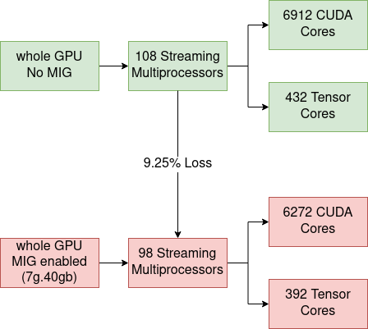
MIG performance penalty for A100

Slide 38
MIG performance penalty
Number of particles | Whole GPU, no MIG [seconds] | Whole GPU, with MIG (7g.40gb) [seconds] | Loss [%]
5 000 000 | 26.365 | 28.732 | 8.97 %
10 000 000 | 51.135 | 55.930 | 9.37 %
15 000 000 | 76.374 | 83.184 | 8.91 %
Conclusion:
The theoretical loss of 9.25% can be seen experimentally as well.

Slide 39
MIG performance penalty
Number of particles | 7g.40gb [s] | 3g.20gb [s] | 2g.10gb [s] | 1g.5gb [s]
5 000 000 | 28.732 | 62.268 | 92.394 | 182.32
10 000 000 | 55.930 | 122.864 | 183.01 | 362.10
15 000 000 | 83.184 | 183.688 | 273.7 | 542.3
Number of particles | 3g.20gb / 7g.40gb | 2g.10gb / 3g.20gb | 1g.5gb / 2g.10gb
5 000 000 | 2.16 | 1.48 | 1.97
10 000 000 | 2.19 | 1.48 | 1.97
15 000 000 | 2.20 | 1.48 | 1.98
ideal scale | 7/3 = 2.33 | 3/2 = 1.5 | 2/1 = 2
Conclusion:
The scaling between partitions converges to the ideal values.

Slide 40


Final conclusions
Category | Examples | Time slicing | MIG
Latency sensitive | CAD, Engineering Applications
Interactive | Notebooks | ¹
Performance intensive | Simulation
Low priority | CI Runners
¹ Independent workloads can trigger OOM errors between each other. Needs an external mechanism to control memory usage (similar to kubelet CPU memory checks)

Slide 41
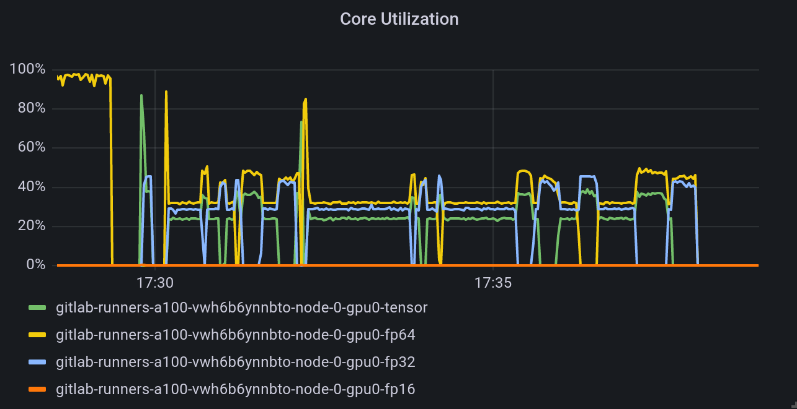

Nice to know/have - Profiling Metrics
Grafana Dashboard
Profiling the A100 compute pipeline utilization

Slide 42



References:
CERN k8s GPU blog posts | NVIDIA Documentation | k8s NVIDIA gpu-operator

Slide 43
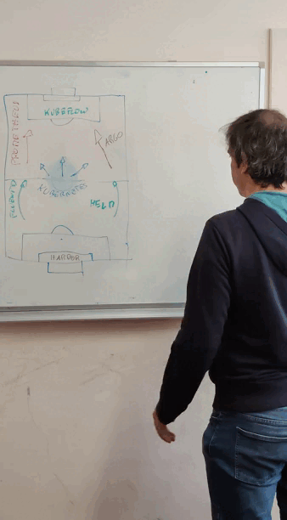
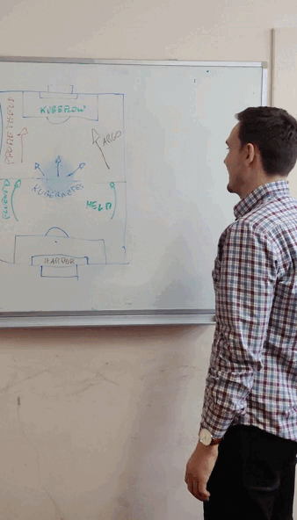

Special thanks:
Acknowledgements:
Reservoir Dogs (1992)
Ricardo Rocha
Dejan Golubovic

Slide 44
Thank you!

